Slide 1
Cultural Intelligence
Semira Amirpour, MBA
The University of Texas at Dallas

Slide 2
Cultural Intelligence Exercise
This activity is utilized in the Intro to Professional Selling Class
Usually takes 45-60 minutes
It’s a combination of lecture and discussion

Slide 3
Pre-Cultural Intelligence Exercise (~ 5 minutes to complete)
Start by defining:
Emotional Intelligence
Culture
Cultural Intelligence

Slide 4
What Does Emotional Intelligence Mean to You?
EQ: the ability to manage your and others’ emotions. Culturally impacted.
This Photo by Unknown Author is licensed under CC BY

Slide 5
What Does Culture Mean to You?
Culture is a set of values, beliefs, norms, and rituals…, that are learned and shared by a group of people.
Culture is the way we see the world through an invisible glass. We do not really understand our culture until we are removed from it.
This Photo by Unknown Author is licensed under CC BY-SA-NC

Slide 6
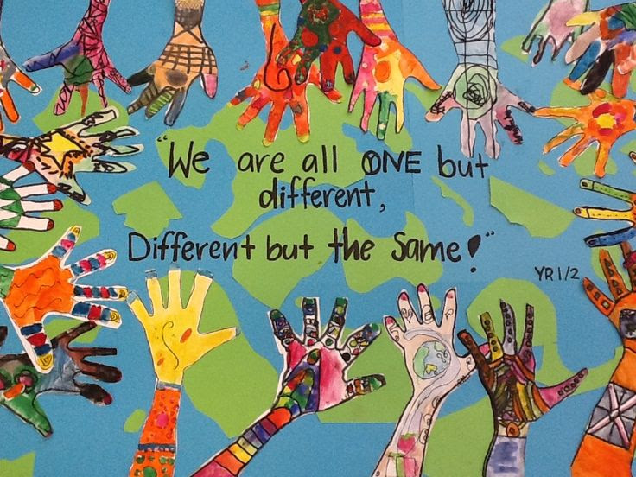
How Do You Define Cultural Intelligence (CQ)?
CQ: measures your capability to relate and work effectively in culturally diverse situations.
This Photo by Unknown Author is licensed under CC BY-NC-ND

Slide 7
What Is The Importance of Cultural Intelligence?
Our success in today’s globalized world requires us to be agile, adaptable and work with others in a variety of cultural situations.
CQ is a valuable skill that can help us work better and more effectively with others.
People open up more if they feel they can be understood.

Slide 8
High CQ does not come automatically, but anyone can develop it!

Slide 9
How Can We Improve Our CQ?
Learn about your own culture!

Slide 10
Cultural Intelligence Exercise Think About Your Own Culture and Write (~10 minutes to complete)
3-5 Things that help you in the business world
Examples:
High emphasis on education
Position of women
Speaking multiple languages
Respect for elder
3-5 things that will hinder you in the business world
Examples:
Concept of time
Acceptance of power distance
Respect for elder
Judgmental

Slide 11
Group Discussion (~25 minutes to complete)
Break down the class into groups of 3-5 students and let them discuss their notes with each other (~5-10 min)
Bring the class together and have each group discuss a few of their findings (~10-15 min)

Slide 12
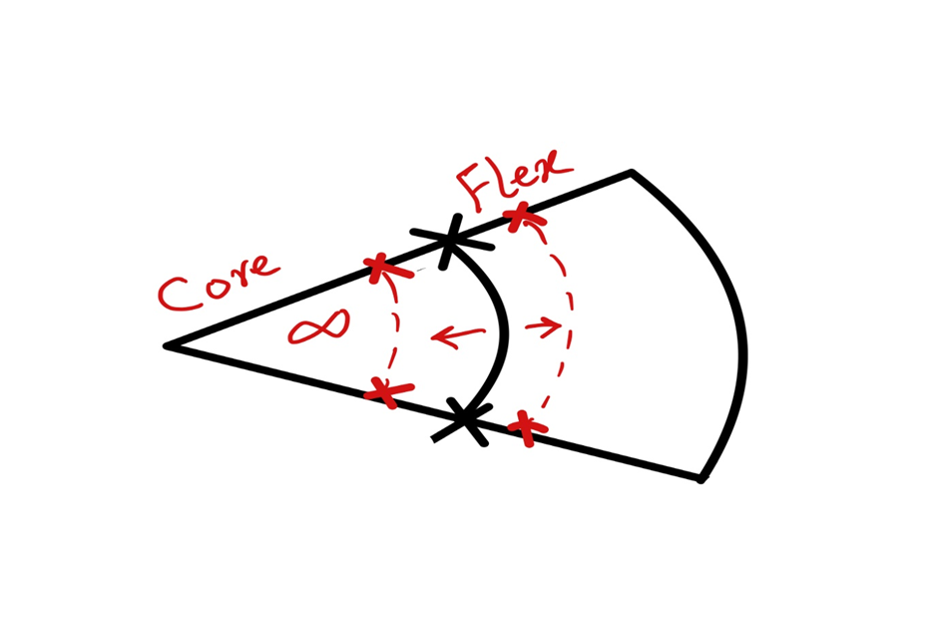
Post-Group Discussion (~10-15 minutes to complete) How Can We Improve Our CQ?
Understand your own Biases!

Slide 13
How Can We Improve our CQ? Become curious about others’ cultures!
How much do you really understand others’ cultures even your friends?
Learn to appreciate all the similarities and differences.

Slide 14
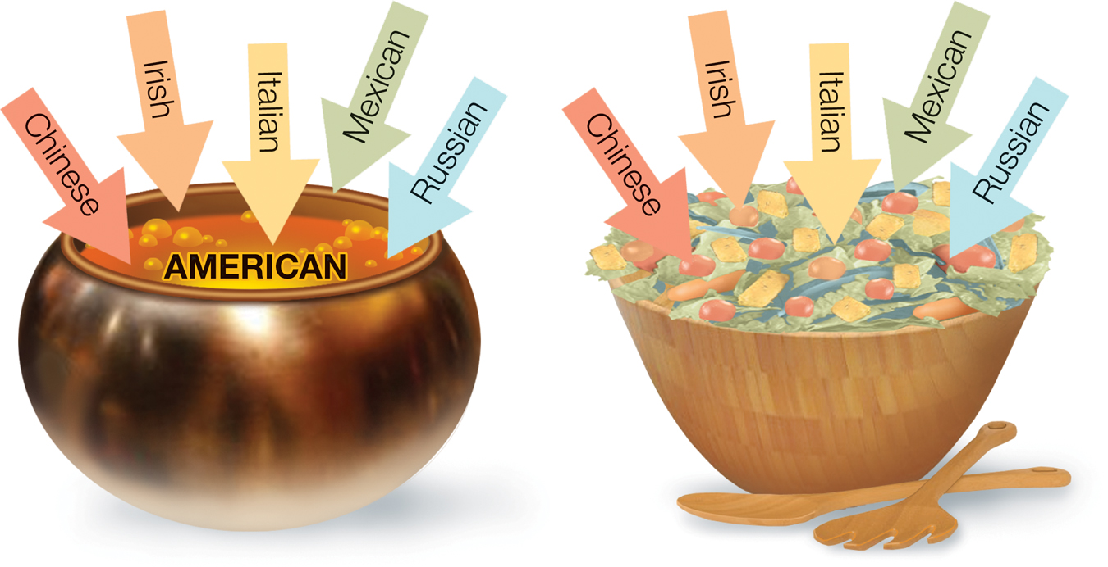
Post-Cultural Intelligence Exercise Discussion (~5-10 minutes to complete) Melting Pot vs. Toss Salad

Slide 15
How Can We Improve Our CQ? Challenge yourself to see the world in the eye of others! Understand that with experience and intentional effort we can all improve our CQ!

Slide 16
Questions/ Comments?
?

